Slide 1
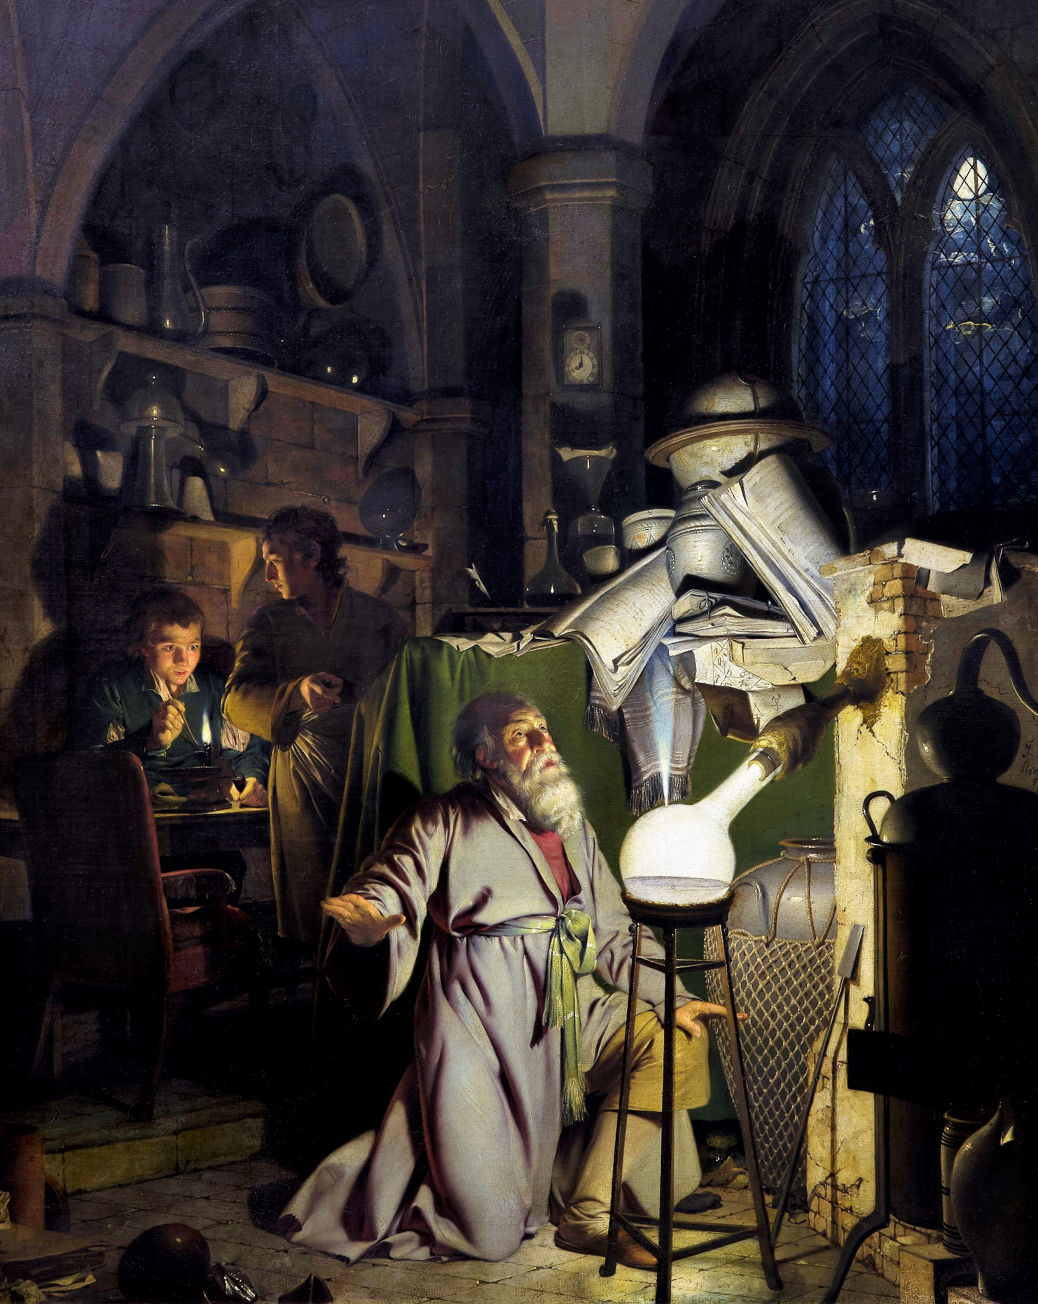

Gather & analyse Data
IL “Scientific Method and Analysis” WS 24-25
Kami Höferl
(Wright of Derby , Wikimedia, PD)
Notes:
"The Alchemist in Search of the Philosopher’s Stone" by Joseph Wright of Derby (1771)
substance capable of turning base metals such as mercury into gold or silver[
In this work, Wright captures an alchemist conducting an experiment with a crucible in search of the philosopher’s stone. The painting portrays a moment of discovery and highlights the experimental process central to early chemistry, before the formalization of modern science.

Slide 2
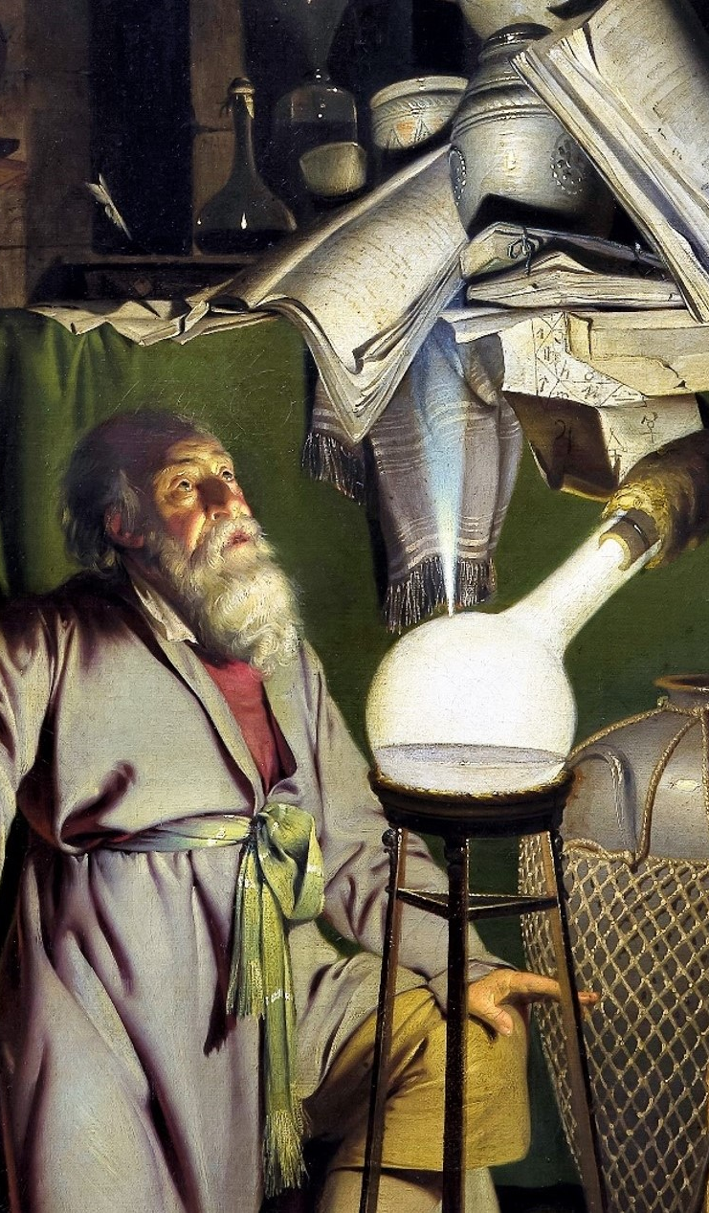
Overview
Gathering data
Analysing data

Slide 3
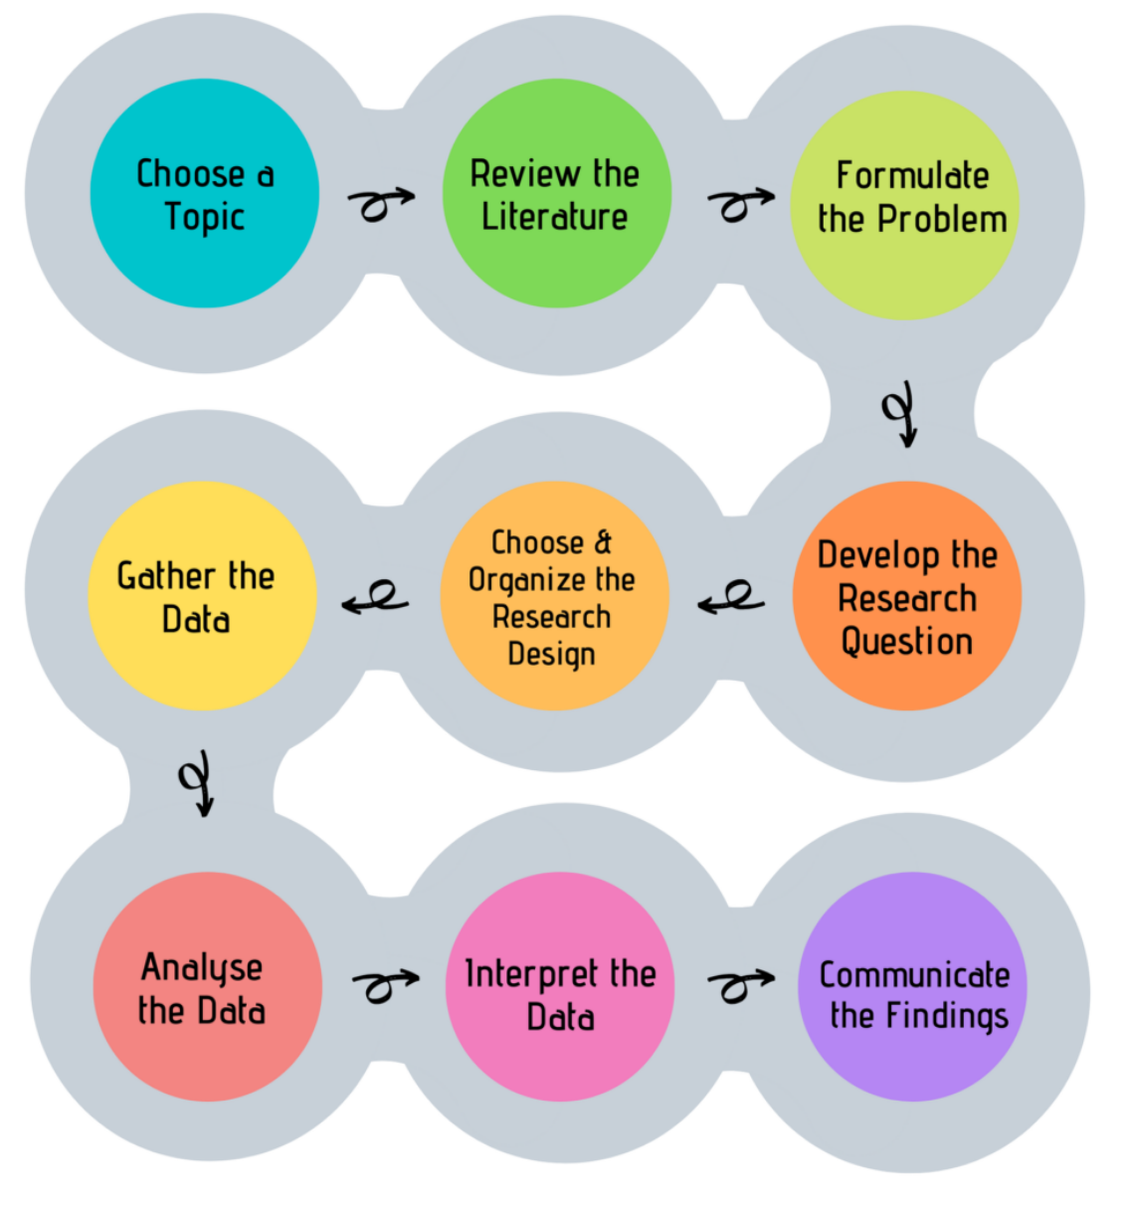
Look, Think, Test, Tell
👉 Main goal:
Understand scientific method

Slide 4
Gathering quantitative Data

Slide 5
Look, Think, Test, Tell

Slide 6
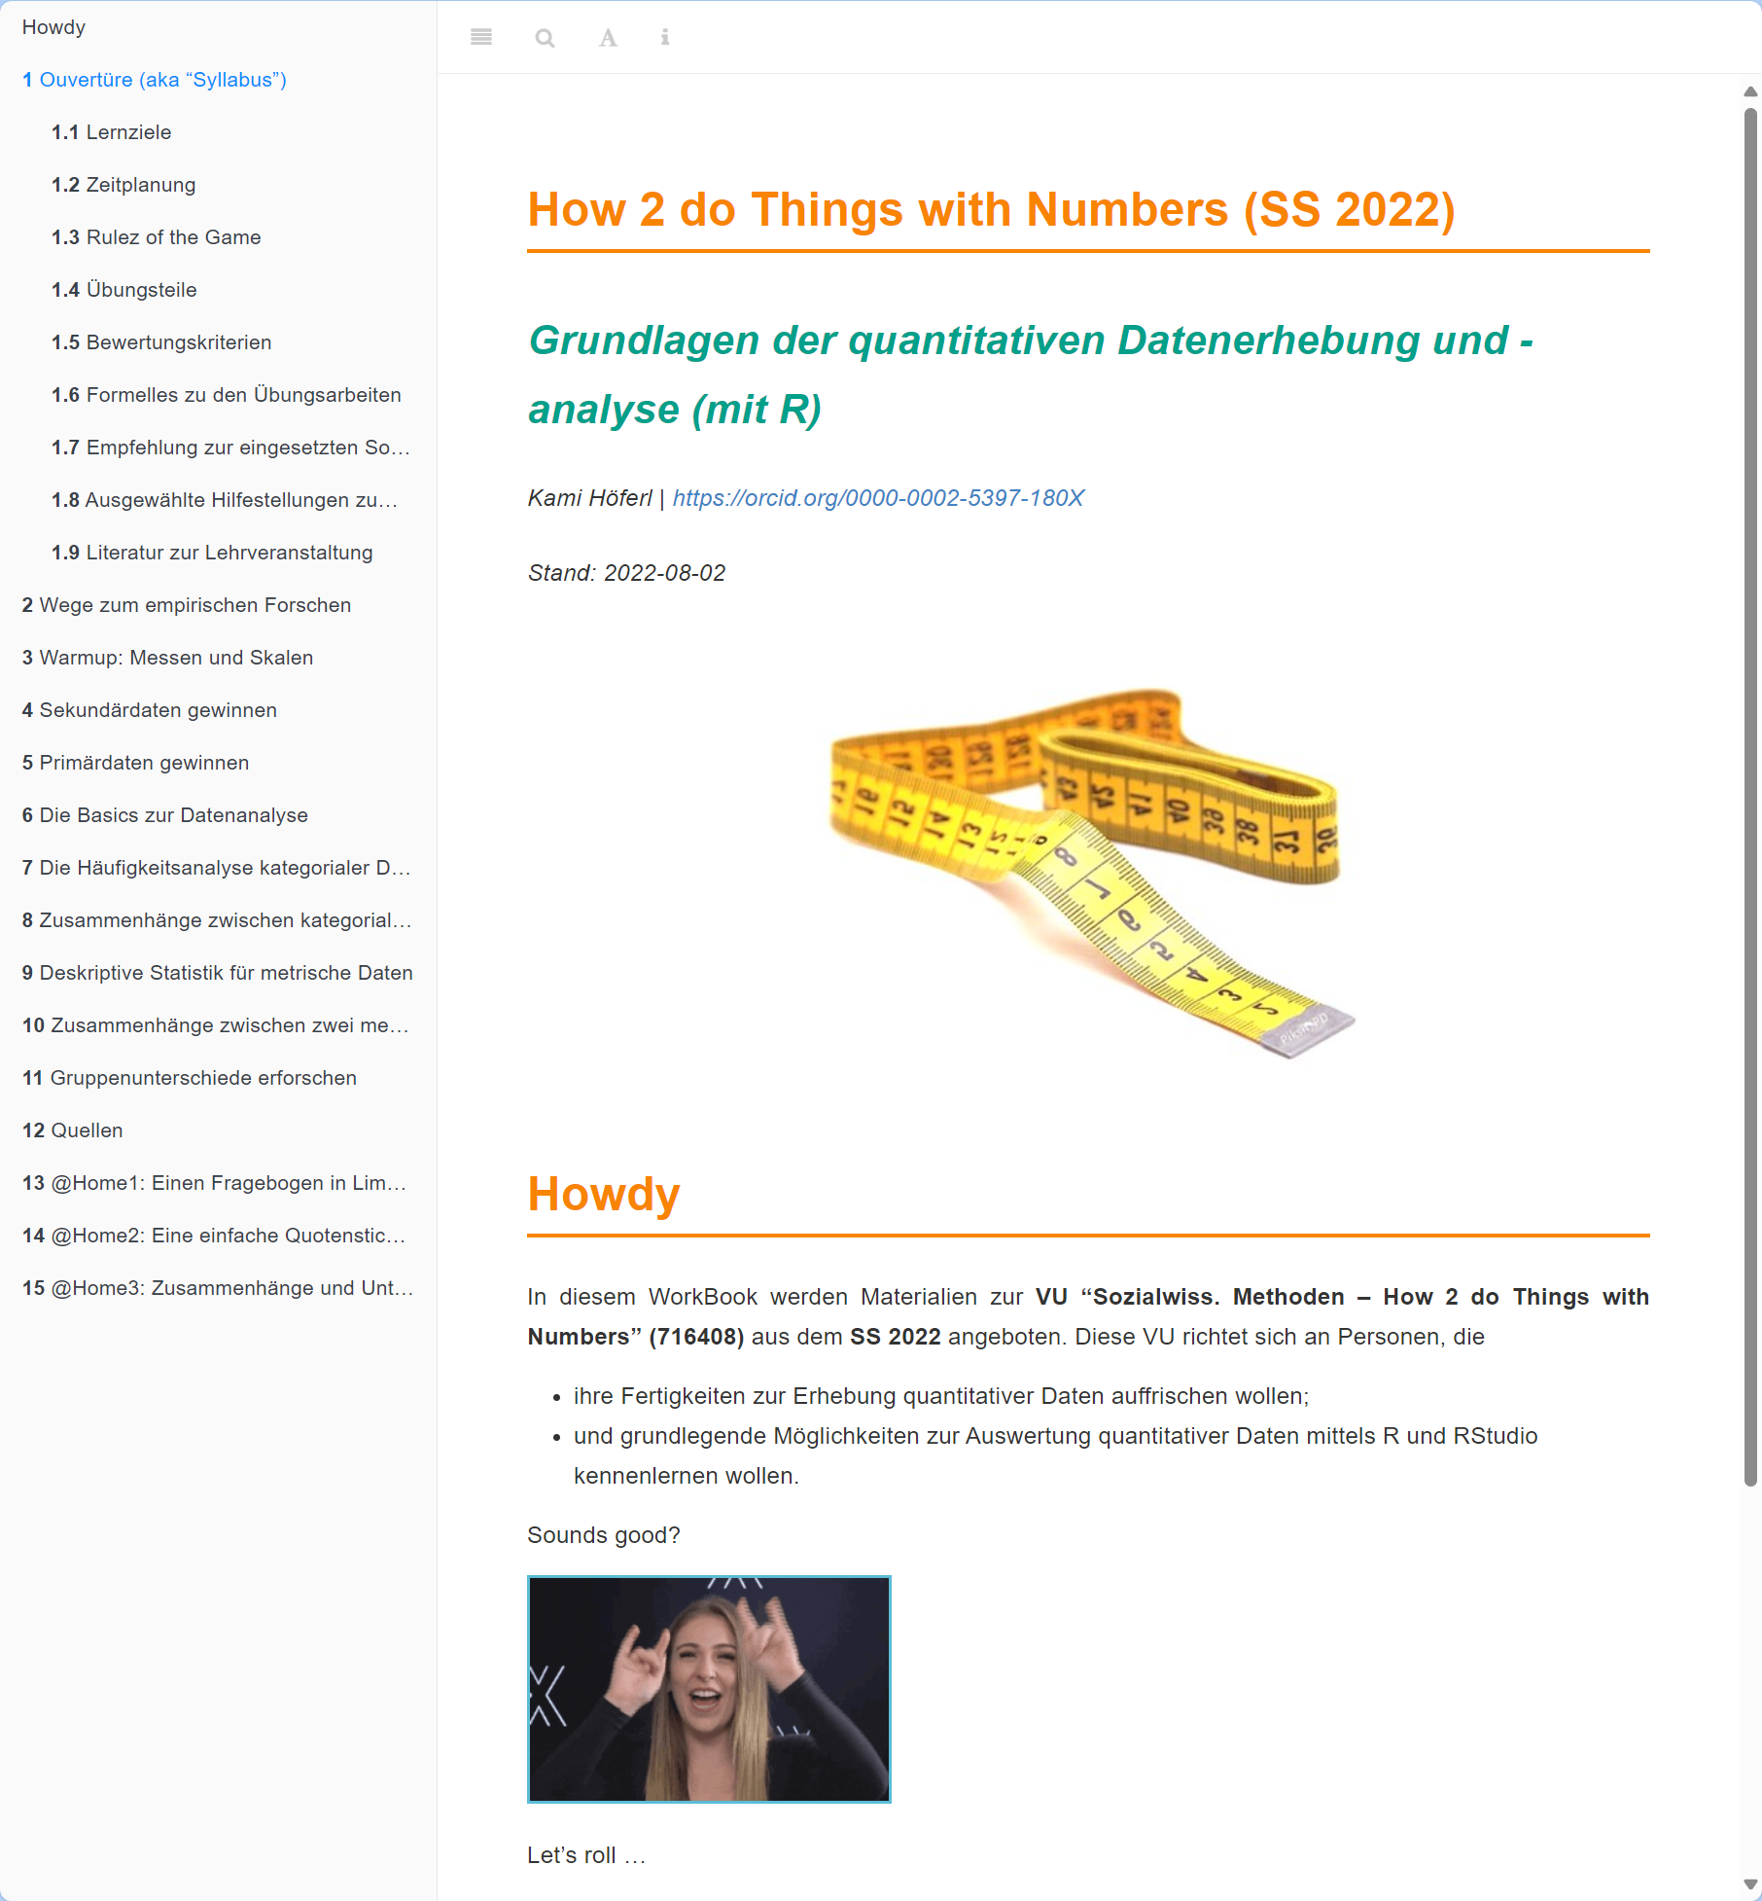
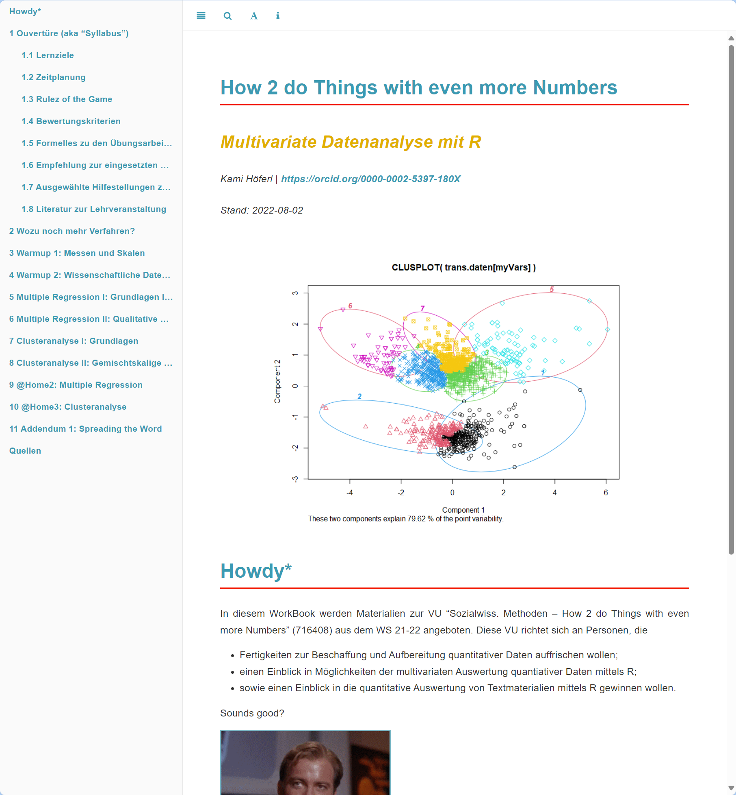
Grab the Data and run …

Slide 7
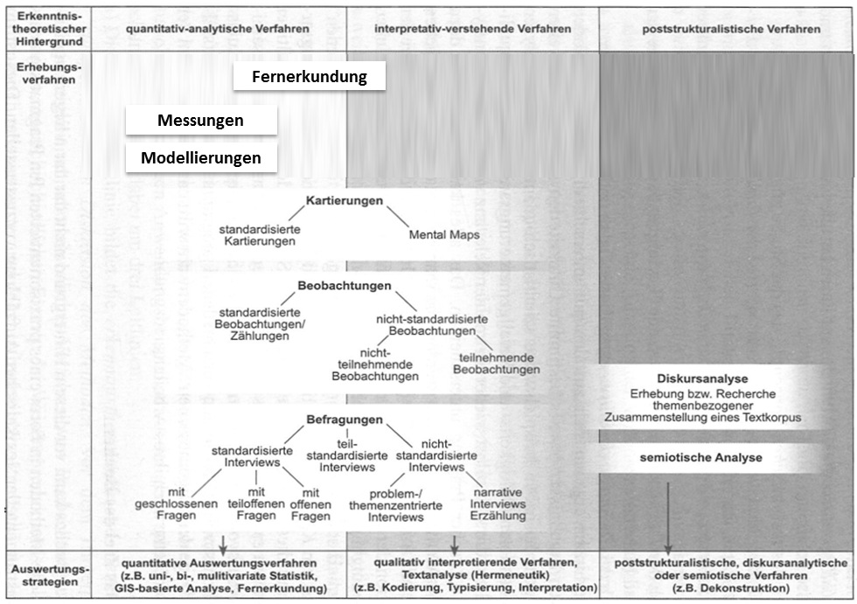
What methods are there? An Overview

Slide 8
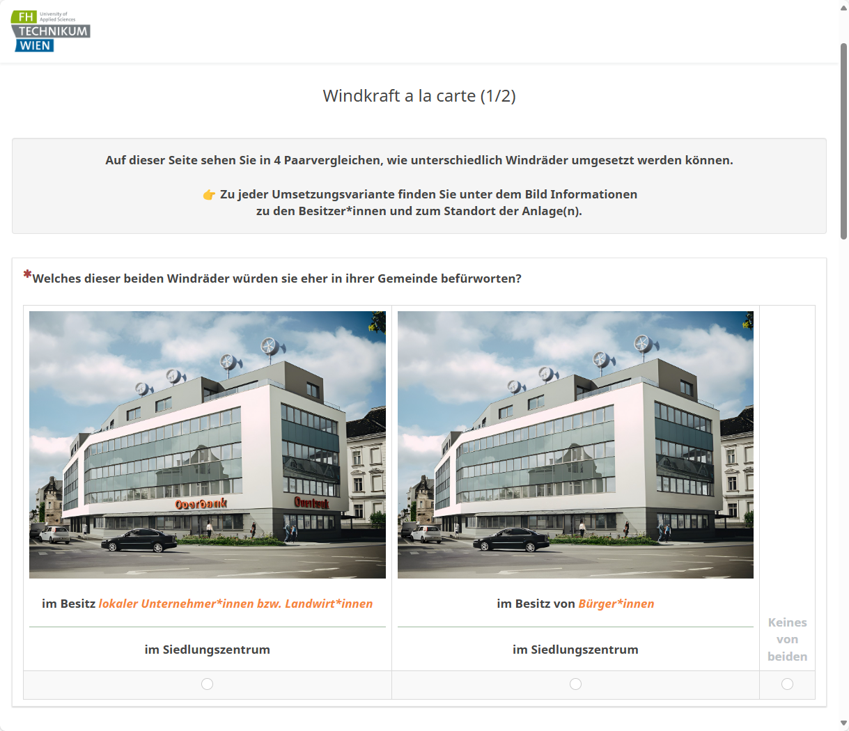
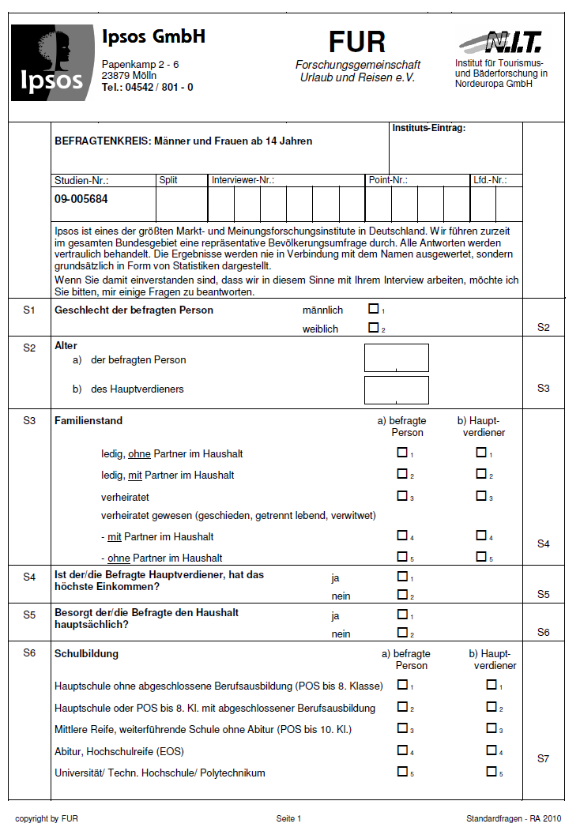
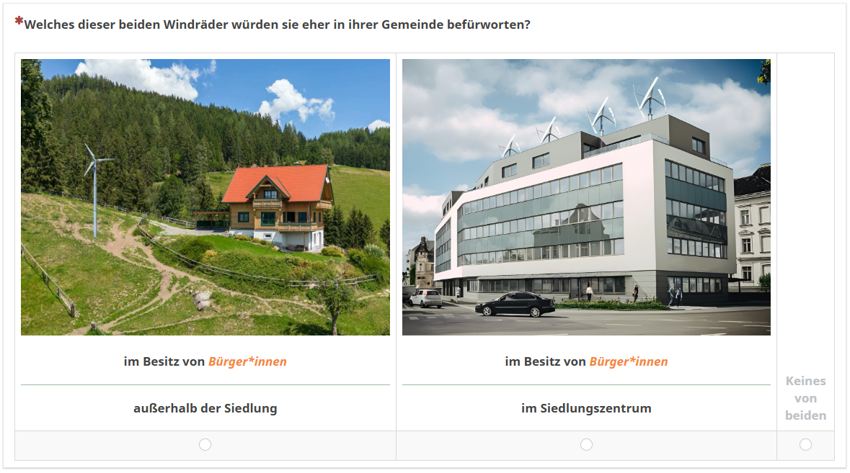
Why not a survey?

Slide 9

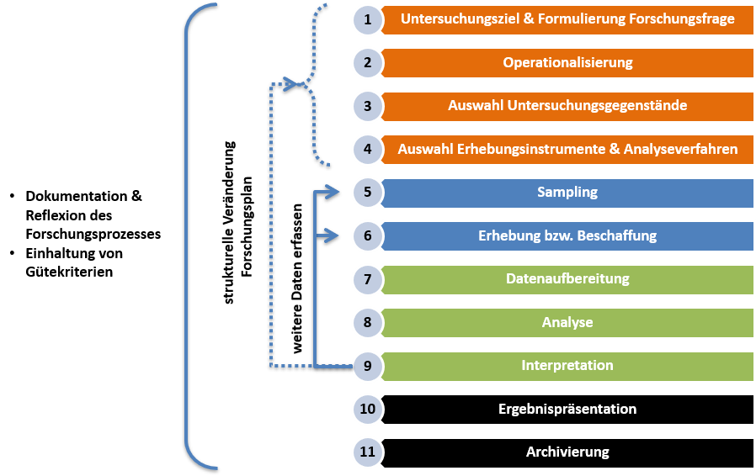
The ideal empirical Workflow

Slide 10
Measurement in Surveys
Measurement = assignment of
a) characteristic values*
b) of characteristic carriers
c) to the characteristic dimensions to be observed.
* coded using number
Manifest Features | Latent Features
Directly measurable | Indirectly measurable (= via indicators)
Age Height Highest educational qualification Income … | Intelligence Sustainable behaviour Resilience / Vulnerability Study satisfaction …

Slide 11
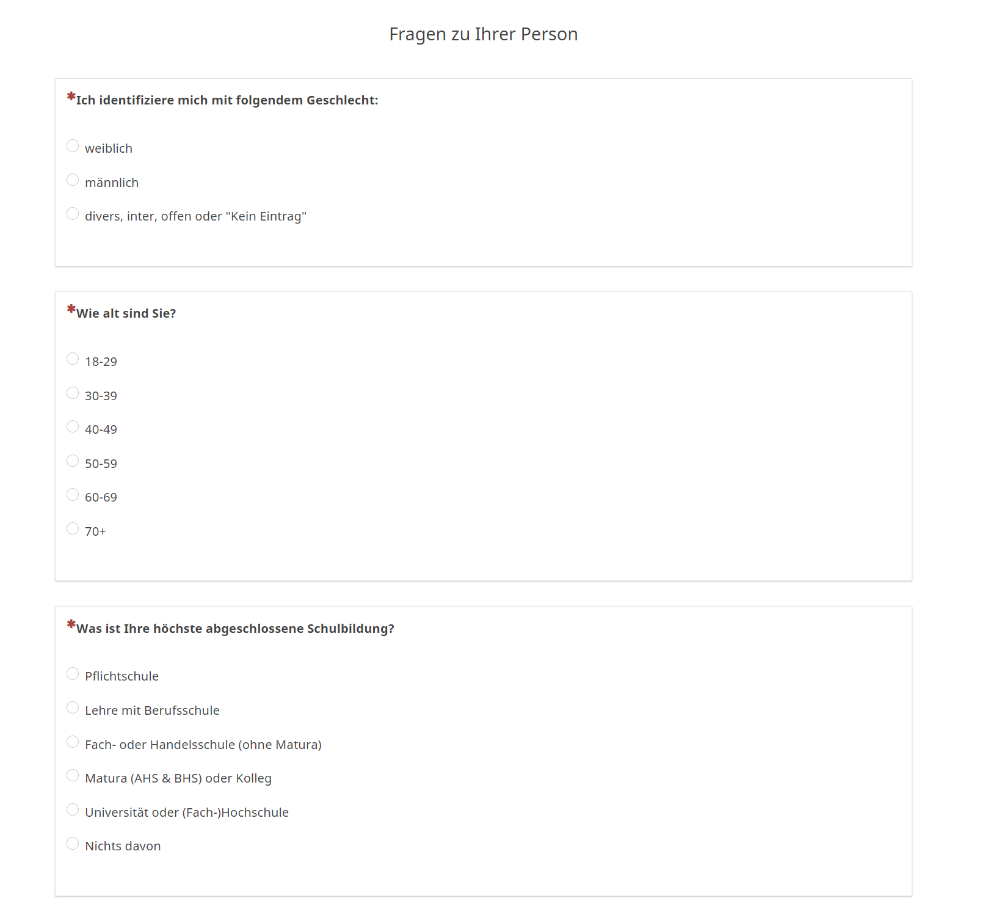
Measuring manifest Features

Slide 12
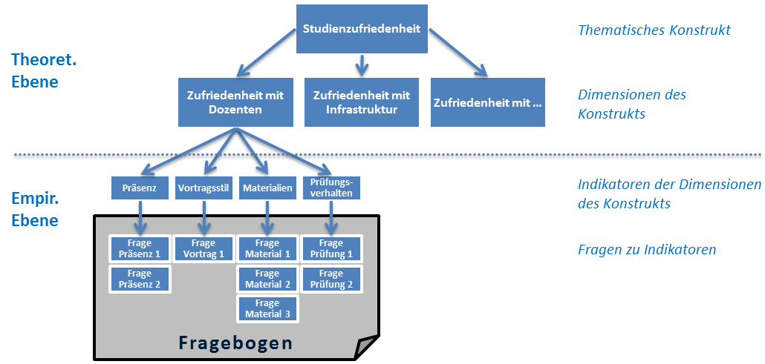
Measuring latent Features

Slide 13
The ideal empirical Workflow

Slide 14
Be clear on the Survey Units
Selection of survey units :
Who should be surveyed?
e.g. households, residents, passers-by, EV-car owner, members of energy communities, …
Selection criteria:
Spatial
Temporal
Characteristics of interest
…

Slide 15
The ideal empirical Workflow

Slide 16
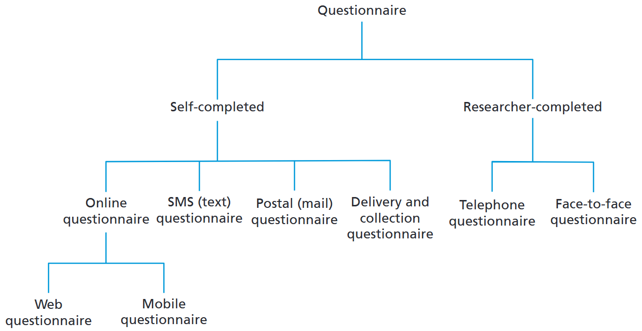
Operationalise your structured Survey

Slide 17
Operationalise your structured Survey
Open questions: Answers "in own words“:
Useful: answer options not fully known; spontaneous answers
Closed questions: Decision between predefined answer alternatives
Useful: Comparability of answers
Time and cost savings
Formulation weaknesses among respondents
Avoid excessive demands on the interviewer when taking notes

Slide 18
Requirements for Response Categories:
Exclusivity of the categories (→ multiple answers)
Completeness of the categories "Remaining category" → Partially open or hybrid questions (additional work in evaluation)
In your opinion, which natural hazards require action from local authorities? Avalanches Floods Other ___________________________________
Concretisation of categories
The respondent must be able to assign categories to observable facts
Limitation of the number of categories
5 to 7 categories

Slide 19
Often used: Scales for Intensities
👉 tool for converting empirical facts into numerical facts
Measurement of frequencies: never - rarely - occasionally - frequently - always
Measurement of intensities: not at all - a little - moderately - predominantly - completely
Measurement of probabilities: not at all - probably not - maybe - quite probably - definitely
Measurement of agreement ("Likert scale"): strongly agree - agree - neutral - tend to disagree – disagree
0 +1 +2 +3 +4
0 +1 +2 +3 +4
0 +1 +2 +3 +4
+2 +1 0 +1 +2

Slide 20
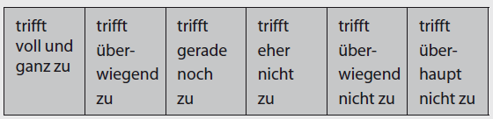
Often used: Scales for Intensities
👉 tool for converting empirical facts into numerical facts
Measurement of frequencies: never - rarely - occasionally - frequently - always
Measurement of intensities: not at all - a little - moderately - predominantly - completely
Measurement of probabilities: not at all - probably not - maybe - quite probably - definitely
Measurement of agreement ("Likert scale"): strongly agree - agree - neutral - tend to disagree – disagree
0 +1 +2 +3 +4
0 +1 +2 +3 +4
+3 +2 +1 -1 -2 -3
0 +1 +2 +3 +4
+2 +1 0 +1 +2

Slide 21
Some Suggestions for formulating Questions
Simple formulations: no technical terms, no double negatives, etc.
"I don't like walking alone„
Short & straight questions
Be specific: "the traffic situation"
(Miss-)Leading questions : "Don't you also mean ..."
Be careful* with emotionally "preloaded" terms
Avoid hypothetical questions: "Suppose you had ..."
Do not overwhelm respondents (e.g. percentages)

Slide 22
Some Suggestions for formulating Questions
questions: one-dimensional
"Are you in favour or against the expansion of XY to improve the traffic situation?"
Questions on distances, frequencies, etc.: 👉provide categories with specified units
"How often do you read a daily newspaper?"
Number of answer categories = „manageable"
5 to 7 categories

Slide 23
Order of Questions:
👉 it depends on the respondents (panel or volunteers)
Introduction:
Make the benefits & purpose of the survey clear
Icebreaker questions: simple questions for introduction
Easy to answer & arouse interest
Main part: core questions on content
Difficult or monotonous questions (blocks)
Funnelling: From the general to the specifi
End:
Demographic characteristics
Length:
Rule of Thumb: < 15 min.

Slide 24
The ideal empirical Workflow

Slide 25
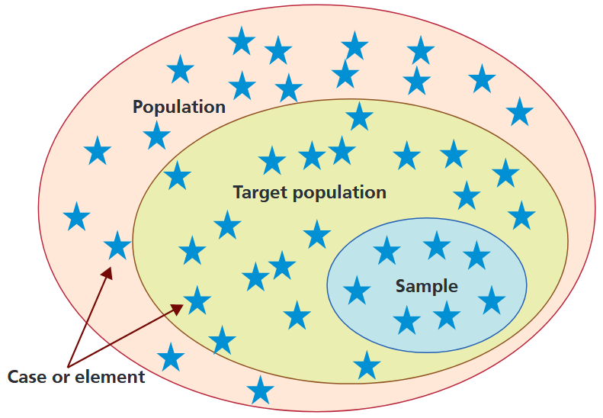
Why is Sampling important?
"Representative":
every element of the population → equal chance of being included in the sample
👉 structural equality = frequency distribution of "important" characteristics in the population exactly reproduced
Prerequisite for drawing conclusions about the population (e.g. ranges)

Slide 26
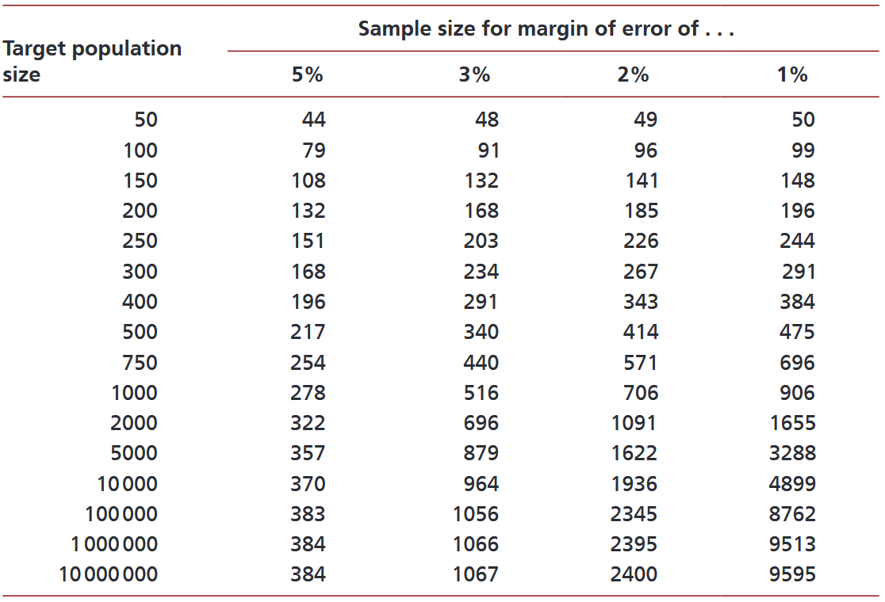
Why is Sampling important?
*
* … based on a 95% confidence level

Slide 27
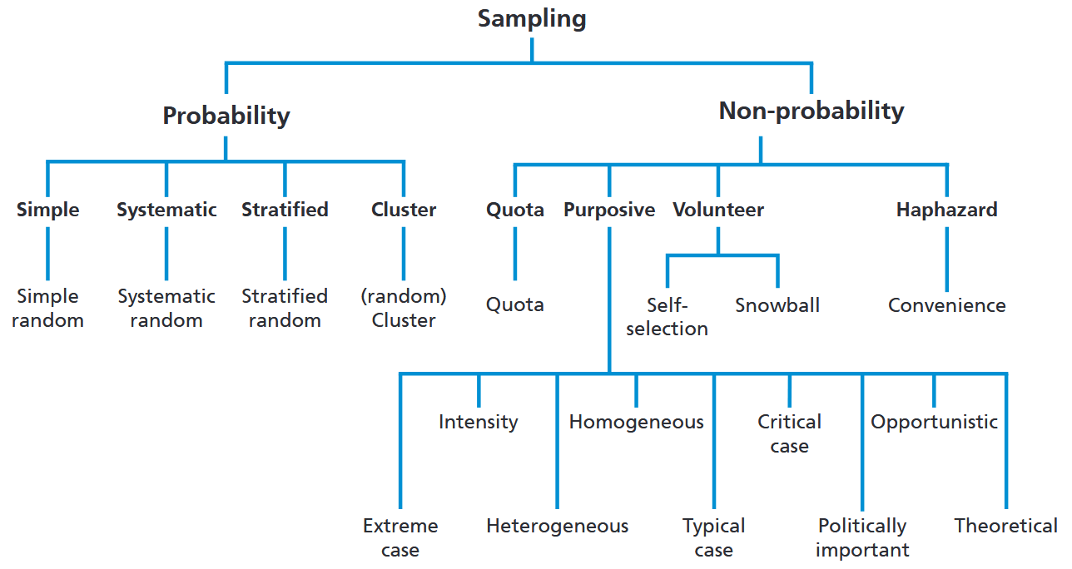
Overview Sampling Strategies

Slide 28
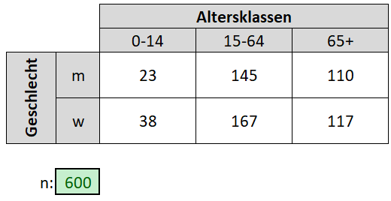
A simple Quota Sampling

Slide 29
The ideal empirical Workflow

Slide 30
Data Preparation: Make it digital!
Data = material that represents (social) facts
Usually not directly analysable:
"the" interview, "the" questionnaire
Quant. Research style:
Coding of response items 👉 Coding Scheme & Coder Training
Digitisation

Slide 31
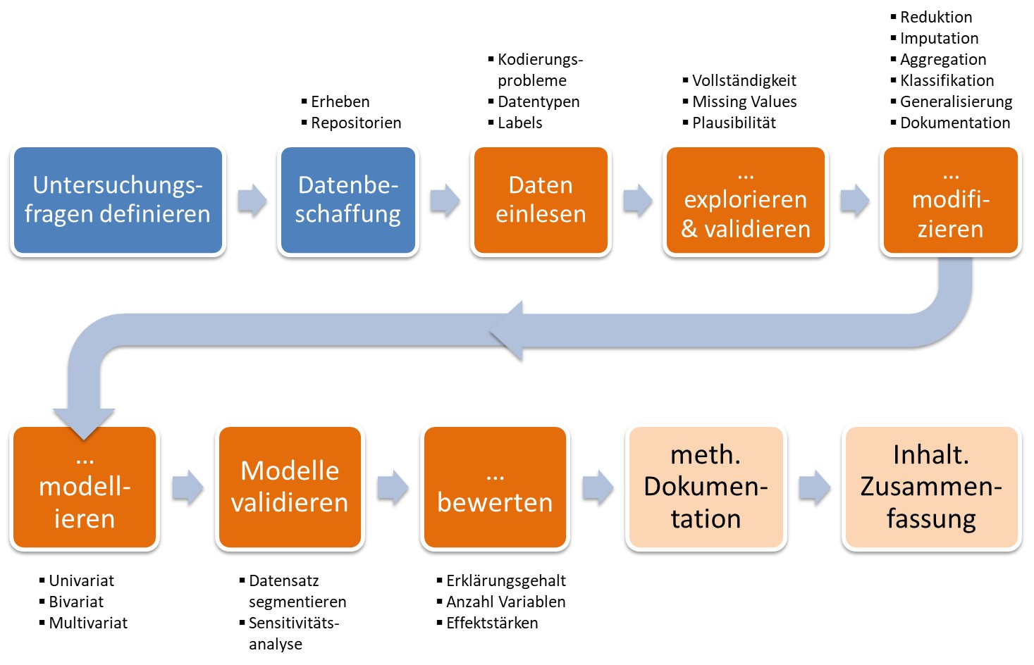
And then: Welcome to the Data Workflow

Slide 32
Gathering qualitative Data

Slide 33

The qualitative Interview
Aim: "subjective view of actors about past events, future plans, opinions, health complaints, relationship problems, experiences in the world of work, etc.“ (Bortz & Döring 2009:308)
Based on open questions → Allows interviewees room for manoeuvre when answering
Takes into account interaction between interviewer and interviewee → follow-up questions etc.
Takes into account impressions & interpretations of the interviewer

Slide 34
Workflow
1. Content preparation
2. Organisational preparation
3. Start of conversation
„Interview“
4. Conducting the interview
5. End of conversation & farewell
6. Interview notes
7.Transcription
8. Content analysis

Slide 35
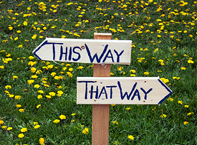
1. Preparation of Content
Definition of survey topic (possibly theoretical background):
Sub-questions: restrictions, development (possibilities), hist. development etc.
👉 Key decisions:
Sampling: Selection of persons to be interviewed
Survey technique: Selection of a suitable survey technique for the survey topic

Slide 36
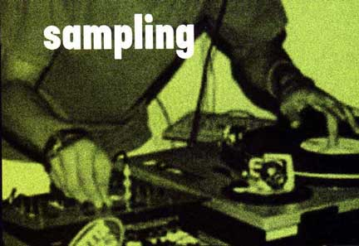
@ Sampling
The "total survey":
For small populations
Deliberate selection:
"Gatekeeper"
Experts
Max/min Contrast
Extreme cases
"Typical" cases
Snowball method:
Ask interviewees about other people to be interviewed
→ no representativeness: „thick" description = cancellation criterion

Slide 37
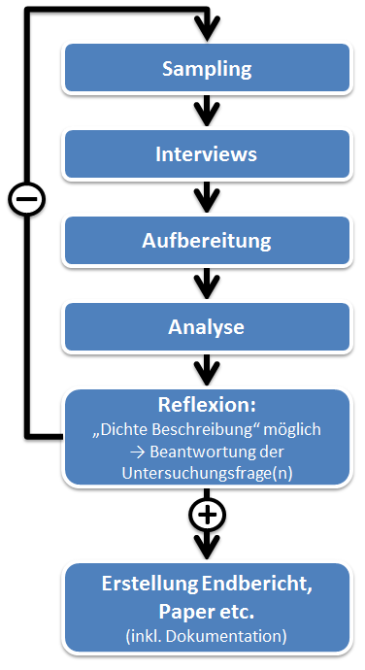
Digression: How many interviews do you need?
Basically: number of interviews = f(research question)
„Thick description": new material 👉 no new description nor interpretation
Pragmatic: dependent on
Resources: time, money & personnel
Who do I want to investigate (= object of investigation)
Rough estimate (MSc.): ~ 10 interviews

Slide 38
Digression: “Thick Description”?
Rich Context: Explains the setting, participants, and circumstances in detail, helping the reader understand the environment in which the phenomenon occurs
Multiple Perspectives: Incorporates diverse viewpoints and experiences to capture the complexity of the situation
Meaning and Interpretation: Goes beyond describing "what happened" to explore "why" and "how" events and behaviours hold particular meanings for participants
Layered Analysis: Links empirical observations to theoretical insights, showing how the data connects to broader social or cultural contexts
Grounded in Data: Stays faithful to the principles of grounded theory by basing interpretations and descriptions directly on empirical data.

Slide 39
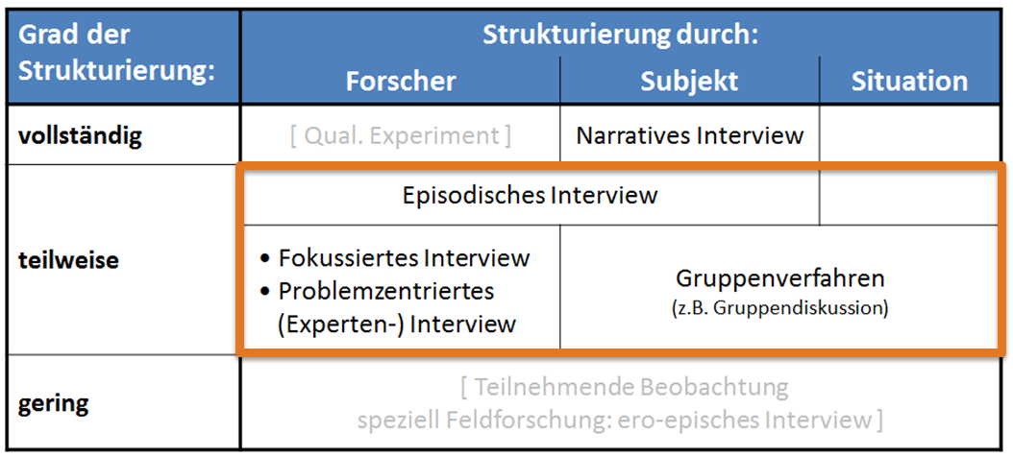
Types of qualitative Interviews

Slide 40
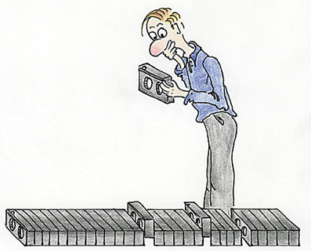
The episodic interview
Goal: discover regularities and rules on the basis of experience (inductive)
Experiences with objects of investigation are based on
narrative-episodic knowledge and
derived from this "semantic" knowledge: generalisations & abstractions
Interviewer lets interviewee narrate, but also asks "own" questions 👉 Combination of narration & targeted questions
Guideline necessary
Possible applications:
Group-specific differences in experiential knowledge

Slide 41
Types of qualitative Interviews

Slide 42
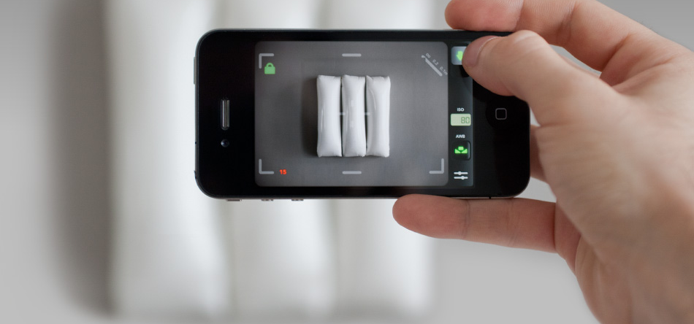
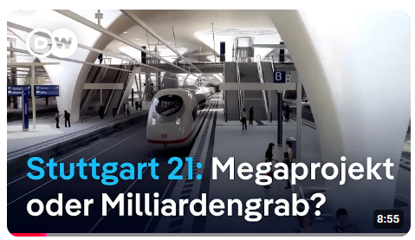
The focussed interview
Objective: Based on a stimulus (e.g. film, planning, etc.), develop & test hypotheses on subjective experiences, perceptions & relevant elements
"Deductive" variant: validate hypotheses in advance & in the interview
Preliminary examination of stimulus on a theoret. Level 👉 guide
Contradiction to respondents' reactions 👉 reject/modify hypotheses
"Inductive" variant: filter out structures in the interviewees' responses 👉 derive theory/hypothesis from this
Transition to narrative interview

Slide 43
Types of qualitative Interviews

Slide 44

The problem-centred interview I
Objective: To check and modify a scientific concept on a relevant problem through the interviewee's statements
Due to prior understanding: Active interviewer asks questions on a "relevant" social problem
Before the interview: Acquire specialist knowledge 👉 structured guide
Theoretical concept not mentioned to interviewee → Openness
If contradiction to the respondent's structuring of meaning 👉 Adaptation of the theoretical concept

Slide 45
The problem-centred interview II
Procedure:
general exploration: narrative example 👉 compulsion to go into detail
Specific details of interrest:
Reflect back: What has been said in your own words
Comprehension questions: for contradictory answers
Confrontation: contradictions, unexplained issues, etc.
Combination with short questionnaire possible
Examples:
Reconstruction of behaviour patterns of specific actors in dealing with problem

Slide 46

Digression: The Interview Guide
Partial standardisation
Content-related considerations on a topic area
👉 Useful if prior knowledge of the topic already exists & certain questions should be at the centre
Contents:
Topics to be addressed in a reasonable order
Possible formulation suggestions / key points
→ Order not necessarily specified, arises in the course of the conversation
→ Tick off questions so as not to forget anything

Slide 47
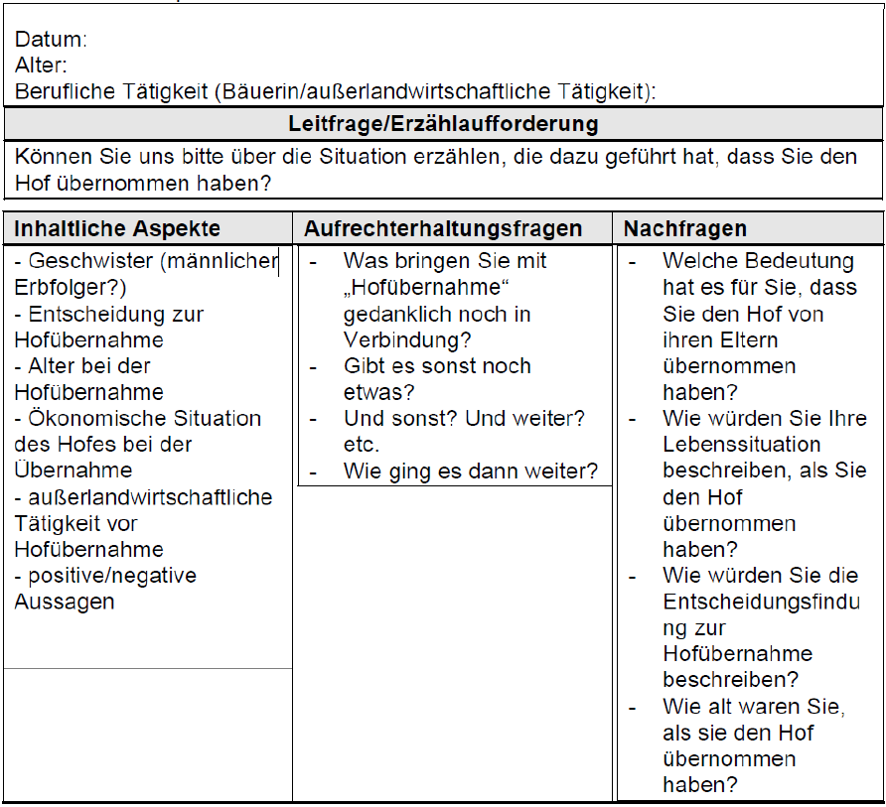
Digression: The Interview Guide
Example „Hofübernahme durch Frauen“ (Heistinger 2006)

Slide 48
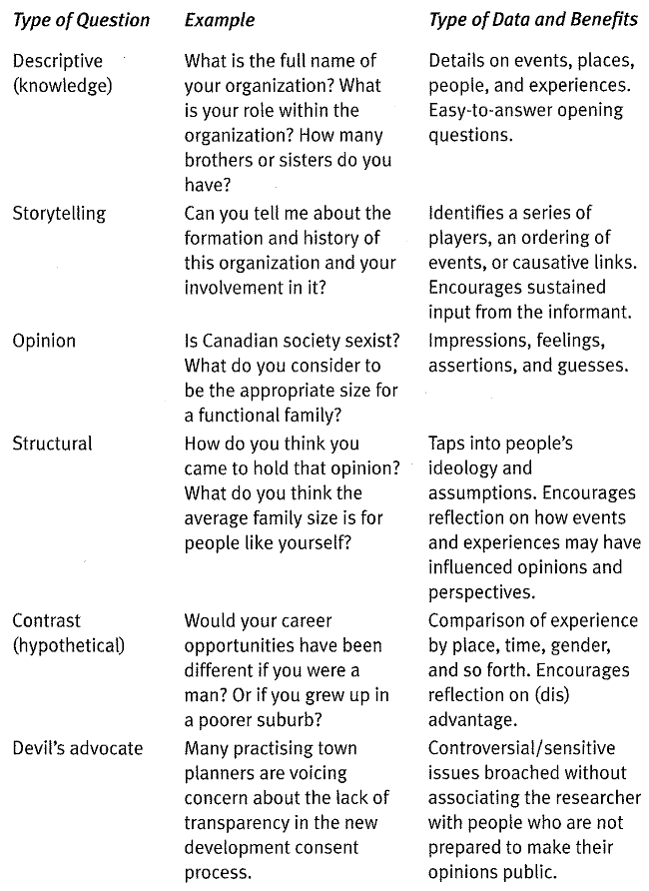
Question Types for the Interview Guide

Slide 49
Workflow
1. Content preparation
2. Organisational preparation
3. Start of conversation
„Interview“
4. Conducting the interview
5. End of conversation & farewell
6. Interview notes
7.Transcription
8. Content analysis

Slide 50
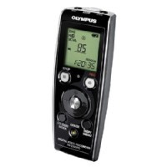
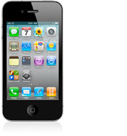
The Workflow
2. Organisational preparation:
Making contact:
Presentation of the topic, purpose of the study, utilisation, etc.
Appointments (👉 interview location)
Hardware:
Training Recording devices, spare batteries, business cards, etc.
3. Start of conversation:
Reference to recording* (& start it 😉)
Introduction & small talk 👉 relaxed atmosphere
4. Conducting the interview:
Managing the process 👉 using guidelines

Slide 51
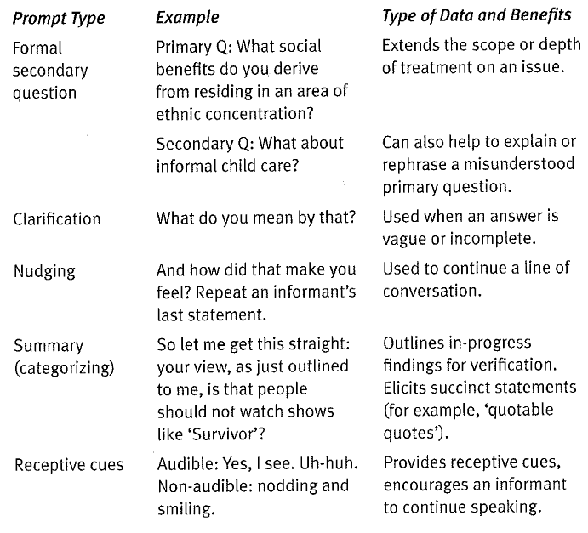
@ Question Strategies during the Interview

Slide 52
Workflow
1. Content preparation
2. Organisational preparation
3. Start of conversation
„Interview“
4. Conducting the interview
5. End of conversation & farewell
6. Interview notes
7.Transcription
8. Content analysis

Slide 53
The Workflow
5. end of conversation & farewell:
Ending the audio recording
Start informal conversation👉 attention & keyword protocol
Farewell:
Business card, information material, utilisation of the results, etc.
6. (Ex post) Interview notes
Additional information on the interview situation
Description of interviewee, interruptions, premises, start & end of interview etc.
Hypotheses, thoughts, striking "sayings" &amp; associated associations

Slide 54
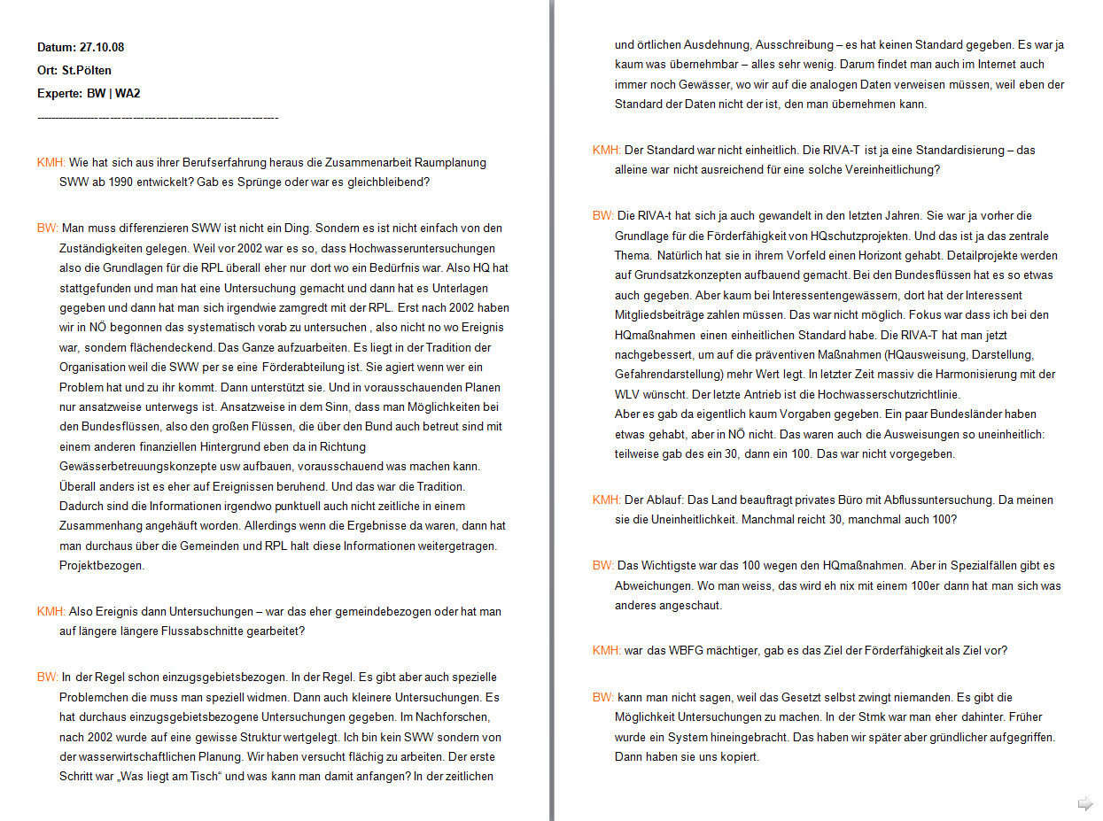
7. Transcription
Mark speakers with capital letters
Blank lines for speaker changes
No "formatting bells and whistles"

Slide 55
Assignment 2: Grade a Seminar Paper

Slide 56
Look, Think, Test, Tell

Slide 57

Outlook on Assignment 2
Your task: Grade a seminar paper
Report design
Scientific formalities
Outline & structuring
Introduction & Conclusion
Argumentation
Form
→
Structure
Content

Slide 58
1. Report design
Title page:
Completeness:
University, Institute
LVA name, number & semester number
Course instructor
Name, matriculation number
Title & subtitle if applicable
Graphic design:
Connection to the topic
Effort
Remaining text:
Completeness:
Table of contents
List of illustrations
Bibliography
Layout:
Readability & orientation
Effort

Slide 59
2. Scientific Formalities 1
Citation - formal:
Selected citation style
Common usage
Standardised usage
Use of short references
Bibliography
Completeness
Structure
Citation - Usage:
Appropriateness of direct quotations
Content
Quantity
Appropriateness of indirect quotations
Content: "Paragraph quotations"
Quantity
Sources cited
Quality
Scope

Slide 60
2. Scientific Formalities 2
Tables, figures and maps:
Citations
Data sources
External images
Design
Labelling: Axes etc.
Graphic / cartographic integrity
Quality
Content
Quality of the underlying data
Clear statements
Integration & explanation in the text
Labelling: Fig. etc.
Necessity for argumentation
Quality of interpretation

Slide 61
3. Outline & Structuring
Continuous text:
Scope of the chapters
Balance between chapters
Structure of chapters
Coherence Heading ↔ Content
One paragraph = 1 thought
Length of the chapters
Correspondence chapter structure ↔ Research objective & questions
Separation of contents & discussion of contents
Table of contents:
Quality of the headings
Coherence of the headings to each other
"Red thread"

Slide 62
4. Introduction & Conclusion 1
Introduction:
Content introduction & motivation
Coherence of content
Linguistic quality
Objective of the study
Clear content
Linguistic quality
Research questions
Clear content
Linguistic quality
Outlook on the structure of the work:
Clear content
Linguistic quality
Conclusion:
General framing
Linguistic quality
Do not embed new findings in the conclusion
Addressing the research objective & questions
Clear content
Clear self-assessment of the provided answers
Linguistic quality

Slide 63
5. Argumentation
Understandability:
Simple language
Length of sentences
Clear definitions of terms
Standardised use of these terms
Logical structure of the main part:
Consistency of the content of the individual chapters
Relationship of the chapters to each other
Clarity
Interim summaries
Transitions between chapters
Comprehensibility
Logic of the arguments used
Justification of choices
Case studies
Independence of the argumentation
Clear labelling of ambiguities etc.
Critical appraisal of the literature

Slide 64
Overall Assessment
Min. 0 & max. 5 points in each of these dimensions:
Report design
Scientific formalities
Outline & structuring
Introduction & Conclusion
Argumentation

Slide 65
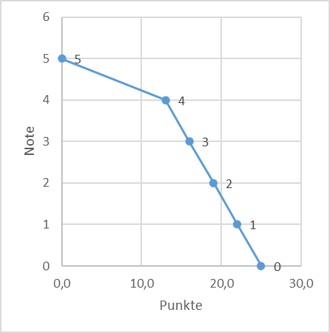
Overall Assessment
Grading scheme:
Cut: 50%
No weighting of dimensions
Punkte | Note
0,0 | 5
13,0 | 4
16,0 | 3
19,0 | 2
22,0 | 1

Slide 66
Outlook on Assignment 2
What? | Length
Cover page | 1 page
Recap of assignemnt & methodology | ~ 0.75 page
Report design | Max. 1/3 page
Scientific formalities | Max. 1/3 page
Outline & structuring | Max. 1/3 page
Introduction & Conclusion | Max. 1/3 page
Argumentation | Max. 1/3 page
Over all Impression & Points | ~ 0.5 page

Slide 67
Outlook on Assignment 2
Your task: Grade a seminar paper
Organisational matters:
Same groups as in 1st assignment
1 PDF A4 for each group
Name of the file: G23_review.pdf
Teams: Upload in folder “2 Assignment”
📅 Deadline: 02.02.25, 23:59

Slide 68
Wrap it up

Slide 69
Wrap it up
XXX

Slide 70
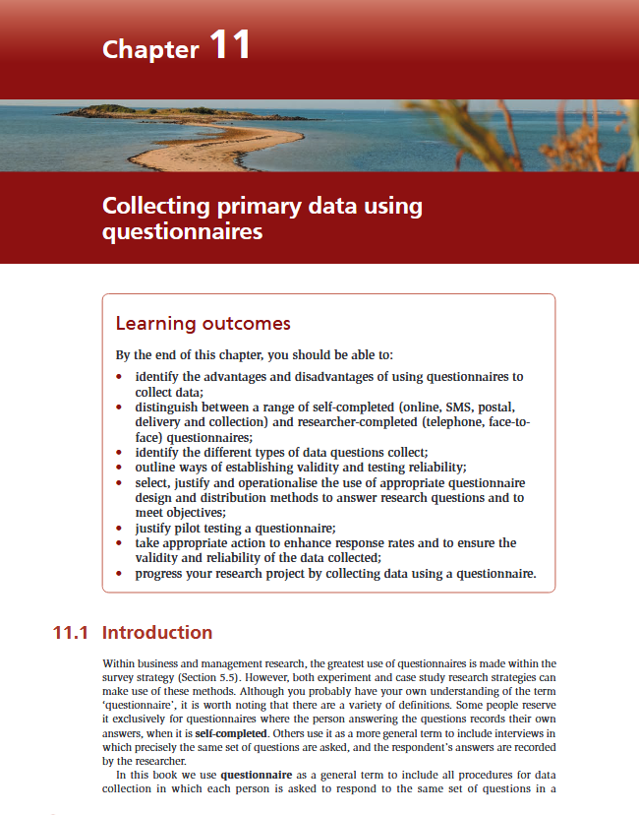
Till next session:
Chapters 11.2 & 11.5 on questionnaires from Saunders et al. (2023)

Slide 71
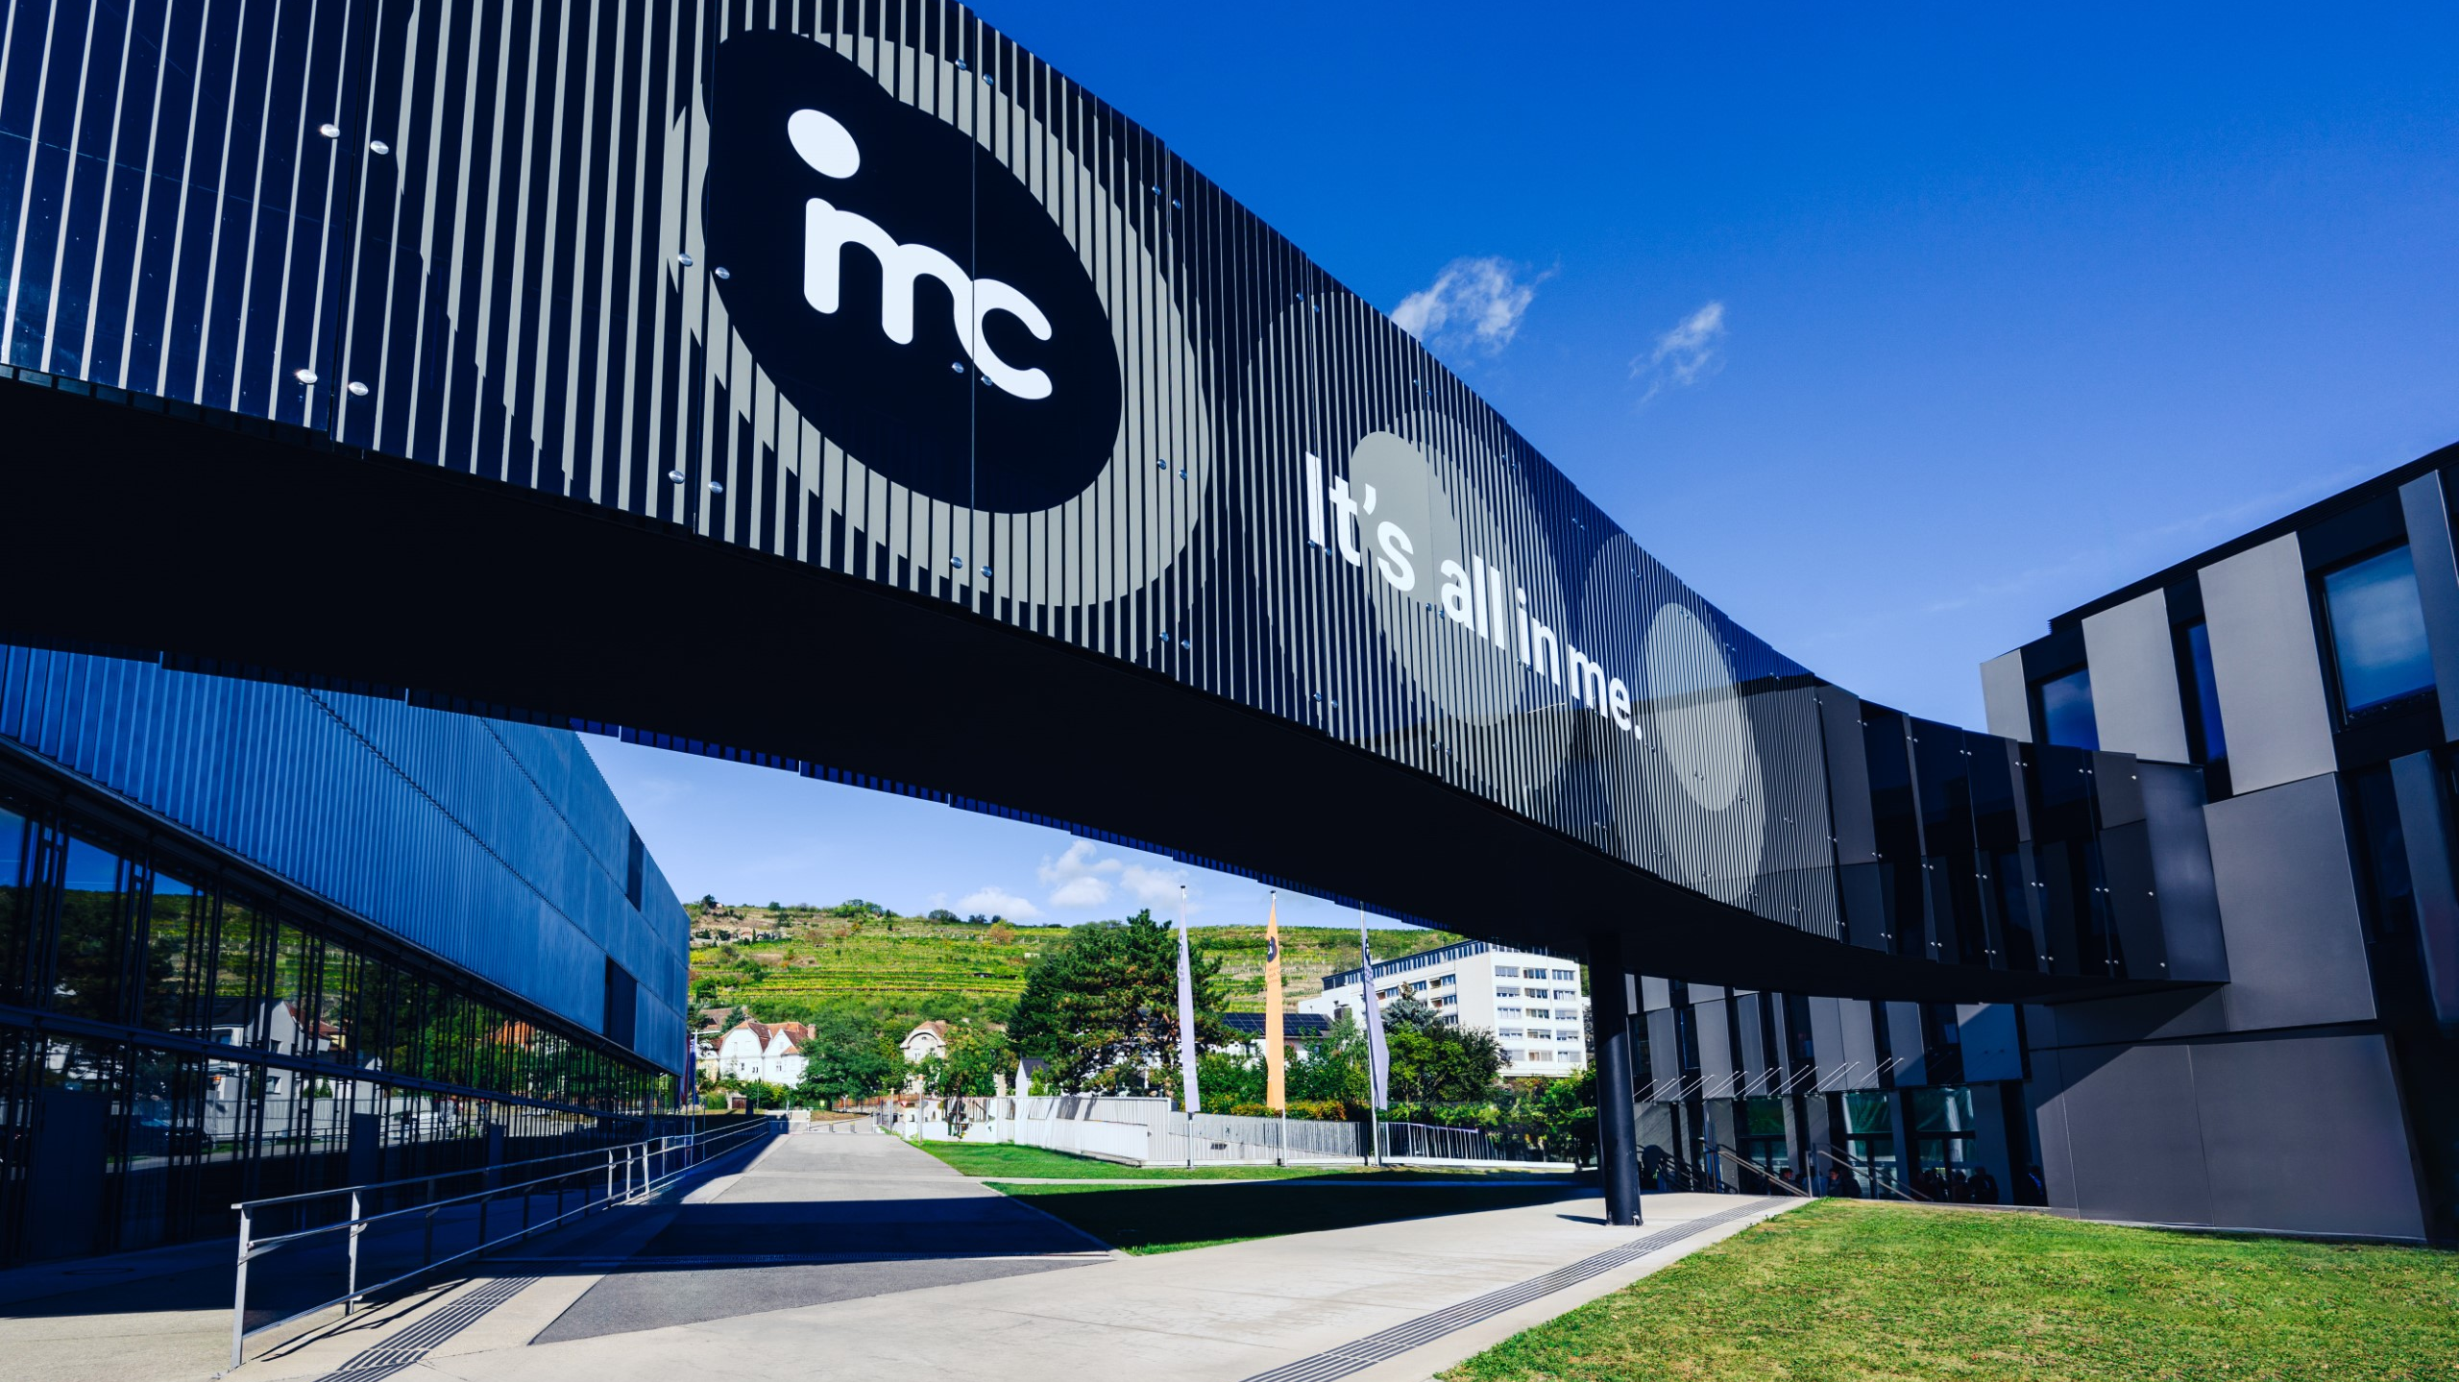
So long & cheerio!

